Slide 1
Potential issue #1
The dog could run away

Slide 2
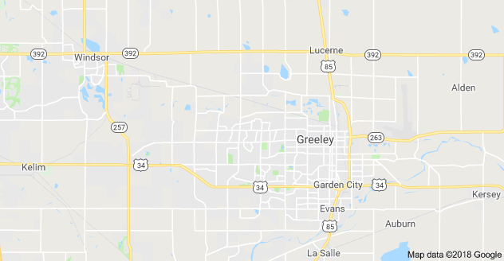
Potential issue #1 - solution
I would use a keychain tracker that I would attach to their collar while I was walking the dog.

Slide 3
Potential issue #2
Multiple dogs might fight

Slide 4
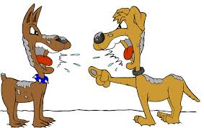
Potential issue #2 - solution
I would only walk one dog at a time and if the business grows, I would have other employees walking one dog at a time.

Slide 5
Potential issue #3
They could poop in people’s yards

Slide 6

Potential issue #3 - solution
I would carry plastic bags with me in a fanny pack that was equipped with extra leashes, other batteries for the tracker, my phone for taking calls and tracking dogs, pepper spray in case I get ambushed by hostile people or dogs.

